Slide 1
HSM102A4-2020US SMOC + 2, 4-D premix: Efficacy and crop safety in Enlist Cotton
Holloway, James
Eure, Pete
2020 Biological Research and Development
Last Updated: Oct-06-2020

Slide 2
Acknowledgements and Test Locations:
Trial | State | Cooperator/ Syngenta Rep | IH/ CRO/ COI | Target | Data was available for the summary presentation (Y/N) | Data was used to answer the protocol objective(s) (Y/N)
USNP0H1412020 | OK | Lindenmayer, Brad | IH | AMAPA | Y | Y
USSB0H0192020 | MS | Jackson, Ryan | IH | BRAPP, SIDSP | Y | Y
USSC0H1122020 | TX | Vandiver, Monti | IH | AMAPA, ECHCG, IPOHE, PROLO | Y | Y
USSD0H1092020 | LA | Moore, Scott | IH | AMAPA, CASOB, ECHCG, IPOHG, OEOLA, PHYAN, SEBEX, SIDSP | Y | Y
USSE0H4202020 | AR | Black, David | IH | BRAPP, IPOLA, MOLVE, PHYAN, SIDSP | Y | Y
USSF0H0032020 | TX | Land, Caroline | IH | AMAPA | Y | Y
USSG0H0232020 | TN | Holloway, James | IH | AMAPA, ELEIN | Y | Y
USSI0H0282020 | GA | McLean, Henry | IH | AMAPA, DIGSA, DTTAE, PORPI, SEBEX | Y | Y
USSJ0H2202020 | NC | Mascarenhas, Victor | IH | AMAPA, IPOLA, MOLVE, POROL | Y | Y
USWA0H1022020 | AZ | Rapicavoli, Jeannette | IH | AMARE, CHEMU, PHYWR, POROL | Y | Y

Slide 3
Objectives:
Do Syngenta tank mixtures with Enlist One or Enlist Duo increase weed control or crop response when applied in Enlist cotton?
Do Syngenta tank mixtures with Enlist One provide greater residual control than Enlist One + Warrant?

Slide 4
Treatment
Trt No. | Trt Name | Product Description | Lot Code | Conc. | Type | Rate | Other Rate | Code | Method | Timing | Placement
1 | UNTREATED CHECK | CHECK
2 | CLASS ACT RIDION | AG 13063 |  |  | SL | 1 % v/v | 1 % V/V | A | NONINC | POSPOS | BROFOL
2 | ENLIST ONE 3.8 SL | 2,4-D (455.34) GAE/L |  | 455.34 gAE/L | SL | 1060 g ae/ha | 2 PT/A | A | NONINC | POSPOS | BROFOL
2 | ROUNDUP POWERMAX 4.5 SL | GLYPHOSATE-POTASSIUM (540) GAE/L |  | 540 gAE/L | SL | 1130 g ae/ha | 28.7 FL OZ/A | A | NONINC | POSPOS | BROFOL
3 | CLASS ACT RIDION | AG 13063 |  |  | SL | 1 % v/v | 1 % V/V | A | NONINC | POSPOS | BROFOL
3 | DUAL MAGNUM | S-METOLACHLOR (913) GA/L |  | 913 gA/L | EC | 1420 g a/ha | 1.33 PT/A | A | NONINC | POSPOS | BROFOL
3 | ENLIST ONE 3.8 SL | 2,4-D (455.34) GAE/L |  | 455.34 gAE/L | SL | 1060 g ae/ha | 2 PT/A | A | NONINC | POSPOS | BROFOL
3 | ROUNDUP POWERMAX 4.5 SL | GLYPHOSATE-POTASSIUM (540) GAE/L |  | 540 gAE/L | SL | 1130 g ae/ha | 28.7 FL OZ/A | A | NONINC | POSPOS | BROFOL
4 | CLASS ACT RIDION | AG 13063 |  |  | SL | 1 % v/v | 1 % V/V | A | NONINC | POSPOS | BROFOL
4 | SEQUENCE 5.25 EW | S-METOLACHLOR/GLYPHOSATE-POTASSIUM (359.49/269.61) G/L |  | 629.1 gAE/L | EW | 2570 g ae/ha | 3.5 PT/A | A | NONINC | POSPOS | BROFOL
4 | ENLIST ONE 3.8 SL | 2,4-D (455.34) GAE/L |  | 455.34 gAE/L | SL | 1060 g ae/ha | 2 PT/A | A | NONINC | POSPOS | BROFOL
5 | CLASS ACT RIDION | AG 13063 |  |  | SL | 1 % v/v | 1 % V/V | A | NONINC | POSPOS | BROFOL
5 | ENVOKE 75 WG | TRIFLOXYSULFURON SODIUM (75) %AW/W |  | 75 %AW/W | WG | 7.88 g a/ha | 0.15 OZ WT/A | A | NONINC | POSPOS | BROFOL
5 | ENLIST ONE 3.8 SL | 2,4-D (455.34) GAE/L |  | 455.34 gAE/L | SL | 1060 g ae/ha | 2 PT/A | A | NONINC | POSPOS | BROFOL
5 | ROUNDUP POWERMAX 4.5 SL | GLYPHOSATE-POTASSIUM (540) GAE/L |  | 540 gAE/L | SL | 1130 g ae/ha | 28.7 FL OZ/A | A | NONINC | POSPOS | BROFOL
6 | CLASS ACT RIDION | AG 13063 |  |  | SL | 1 % v/v | 1 % V/V | A | NONINC | POSPOS | BROFOL
6 | ENLIST DUO | GLYPHOSATE-DIMETHYLAMINE/2,4-D CHOLINE SALT (204/194) G/L |  | 398 gAE/L | SL | 2210 g ae/ha | 4.75 PT/A | A | NONINC | POSPOS | BROFOL
7 | CLASS ACT RIDION | AG 13063 |  |  | SL | 1 % v/v | 1 % V/V | A | NONINC | POSPOS | BROFOL
7 | DUAL MAGNUM | S-METOLACHLOR (913) GA/L |  | 913 gA/L | EC | 1420 g a/ha | 1.33 PT/A | A | NONINC | POSPOS | BROFOL
7 | ENLIST DUO | GLYPHOSATE-DIMETHYLAMINE/2,4-D CHOLINE SALT (204/194) G/L |  | 398 gAE/L | SL | 2210 g ae/ha | 4.75 PT/A | A | NONINC | POSPOS | BROFOL

Slide 5
Treatment
Trt No. | Trt Name | Product Description | Lot Code | Conc. | Type | Rate | Other Rate | Code | Method | Timing | Placement
8 | CLASS ACT RIDION | AG 13063 |  |  | SL | 1 % v/v | 1 % V/V | A | NONINC | POSPOS | BROFOL
8 | ENVOKE 75 WG | TRIFLOXYSULFURON SODIUM (75) %AW/W |  | 75 %AW/W | WG | 7.88 g a/ha | 0.15 OZ WT/A | A | NONINC | POSPOS | BROFOL
8 | ENLIST DUO | GLYPHOSATE-DIMETHYLAMINE/2,4-D CHOLINE SALT (204/194) G/L |  | 398 gAE/L | SL | 2210 g ae/ha | 4.75 PT/A | A | NONINC | POSPOS | BROFOL
9 | CLASS ACT RIDION | AG 13063 |  |  | SL | 1 % v/v | 1 % V/V | A | NONINC | POSPOS | BROFOL
9 | WARRANT 3 CS | ACETOCHLOR (359) GA/L |  | 359 gA/L | CS | 1260 g a/ha | 48 FL OZ/A | A | NONINC | POSPOS | BROFOL
9 | ENLIST ONE 3.8 SL | 2,4-D (455.34) GAE/L |  | 455.34 gAE/L | SL | 1060 g ae/ha | 2 PT/A | A | NONINC | POSPOS | BROFOL
9 | ROUNDUP POWERMAX 4.5 SL | GLYPHOSATE-POTASSIUM (540) GAE/L |  | 540 gAE/L | SL | 1130 g ae/ha | 28.7 FL OZ/A | A | NONINC | POSPOS | BROFOL

Slide 6
Crop/Weed stage and height
Trial | Application_Date | Crop | Pest | Crop_Pest_Min_Stage | Crop_Pest_Max_Stage | Crop_Pest_Majority_Stage | Crop_Pest_Min_Height | Crop_Pest_Max_Height | Crop_Pest_Height_Unit
USNP0H1412020 | 02-Jun-2020 |  | Amaranthus palmeri | 14 | 51 | 26 | 1 | 6 | IN
USNP0H1412020 | 02-Jun-2020 | Cotton plant |  | 10 | 12 | 11 | 2 | 4 | in
USSB0H0192020 | 07-Jun-2020 |  | Brachiaria platyphylla | 12 | 23 | 14 | 2 | 7 | IN
USSB0H0192020 | 07-Jun-2020 |  | Sida spinosa | 11 | 19 | 15 | 1 | 5 | IN
USSB0H0192020 | 07-Jun-2020 | American upland cotton |  | 13 | 14 | 14 | 6 | 8 | IN
USSC0H1122020 | 22-Jun-2020 |  | Amaranthus palmeri | 10 | 19 | 16 | 0.25 | 4 | IN
USSC0H1122020 | 22-Jun-2020 |  | Ipomoea hederacea | 10 | 19 | 16 | 0.5 | 4 | IN
USSC0H1122020 | 22-Jun-2020 |  | Proboscidea sp. | 10 | 14 | 12 | 0.5 | 4 | IN
USSC0H1122020 | 22-Jun-2020 | Cotton plant |  | 14 | 16 | 15 | 3 | 4 | IN
USSD0H1092020 | 29-May-2020 |  | Amaranthus palmeri | 12 | 16 | 15 | 2 | 8 | IN
USSD0H1092020 | 29-May-2020 |  | Ipomoea hederacea integriuscul | 12 | 16 | 14 | 2 | 6 | IN
USSD0H1092020 | 29-May-2020 |  | Oenothera laciniata | 51 | 67 | 65 | 4 | 8 | IN
USSD0H1092020 | 29-May-2020 |  | Physalis angulata | 11 | 14 | 12 | 1 | 4 | IN
USSD0H1092020 | 29-May-2020 |  | Senna obtusifolia | 12 | 14 | 13 | 3 | 6 | IN
USSD0H1092020 | 29-May-2020 |  | Sesbania herbacea | 11 | 13 | 12 | 2 | 4 | IN
USSD0H1092020 | 29-May-2020 |  | Sida spinosa | 11 | 16 | 14 | 2 | 8 | IN
USSD0H1092020 | 29-May-2020 | Cotton plant |  | 13 | 15 | 14 | 5 | 8 | IN
USSE0H4202020 | 15-Jun-2020 |  | Brachiaria platyphylla | 14 | 24 | 23 | 3.5 | 6 | IN
USSE0H4202020 | 15-Jun-2020 |  | Ipomoea lacunosa | 10 | 19 | 16 | 1 | 10 | IN
USSE0H4202020 | 15-Jun-2020 |  | Mollugo verticillata | 14 | 19 | 16 | 0.5 | 2 | IN
USSE0H4202020 | 15-Jun-2020 |  | Sida spinosa | 10 | 16 | 14 | 1 | 3 | IN
USSE0H4202020 | 15-Jun-2020 | Cotton plant |  | 10 | 10 | 10 | 3 | 3.5 | IN
USSE0H4202020 | 15-Jun-2020 | Cotton plant |  | 13 | 13 | 13 | 5 | 6 | IN
USSF0H0032020 | 18-May-2020 |  | Amaranthus palmeri
USSF0H0032020 | 18-May-2020 | Cotton plant |  | 12 | 13 | 12 | 4 | 6 | IN
USSG0H0232020 | 01-Jun-2020 |  | Amaranthus palmeri | 19 | 19 | 12 | 0.5 | 12 | IN
USSG0H0232020 | 01-Jun-2020 |  | Eleusine indica | 19 | 19 | 13 | 2 | 4 | IN
USSG0H0232020 | 01-Jun-2020 | Cotton plant |  | 11 | 12 | 12 | 4 | 5 | IN
USSI0H0282020 | 26-Jun-2020 |  | Amaranthus palmeri | 16 | 19 | 18 | 3 | 12 | IN
USSI0H0282020 | 26-Jun-2020 |  | Dactyloctenium aegyptium | 22 | 24 | 23 | 1 | 1 | IN
USSI0H0282020 | 26-Jun-2020 |  | Digitaria sanguinalis | 22 | 24 | 23 | 1 | 1 | IN
USSI0H0282020 | 26-Jun-2020 |  | Mollugo verticillata | 19 | 19 | 19 | 0.5 | 0.5 | IN
USSI0H0282020 | 26-Jun-2020 |  | Portulaca pilosa | 19 | 19 | 19 | 0.5 | 0.5 | IN
USSI0H0282020 | 26-Jun-2020 |  | Sesbania herbacea | 13 | 14 | 13 | 3 | 6 | IN
USSI0H0282020 | 26-Jun-2020 | American upland cotton |  | 13 | 13 | 13 | 7 | 8 | IN
USSJ0H2202020 | 26-Jun-2020 |  | Amaranthus palmeri | 14 | 19 | 16 | 0.5 | 3.5 | IN
USSJ0H2202020 | 26-Jun-2020 |  | Ipomoea lacunosa | 12 | 13 | 12 | 1 | 2 | IN
USSJ0H2202020 | 26-Jun-2020 |  | Mollugo verticillata | 12 | 16 | 14 | 0.25 | 0.25 | IN
USSJ0H2202020 | 26-Jun-2020 |  | Portulaca oleracea | 17 | 22 | 19 | 0.5 | 1.5 | IN
USSJ0H2202020 | 26-Jun-2020 | Cotton plant |  | 11 | 12 | 11 | 2.5 | 4.5 | IN
USWA0H1022020 | 22-May-2020 |  | Amaranthus retroflexus | 14 | 23 | 21 | 1 | 4 | IN
USWA0H1022020 | 22-May-2020 |  | Chenopodium sp. | 14 | 23 | 21 | 1 | 4 | IN
USWA0H1022020 | 22-May-2020 |  | Physalis sp. | 12 | 16 | 14 | 1 | 4 | IN
USWA0H1022020 | 22-May-2020 |  | Portulaca oleracea | 13 | 23 | 22 | 1 | 4 | IN

Slide 7
MAX PHYGEN

Slide 8
MAX PHYSTU

Slide 9
Broadleaf weed control – 7 DAA

Slide 10
Broadleaf weed control – 14 DAA

Slide 11
Broadleaf weed control – 28 DAA

Slide 12
Broadleaf weed control – 28 DAA – new emergence

Slide 13
Broadleaf weed control – 42 DAA

Slide 14
Broadleaf weed control – 42 DAA – new emergence

Slide 15
Grass weed control – 7 DAA

Slide 16
Grass weed control – 14 DAA

Slide 17
Grass weed control – 28 DAA

Slide 18
Grass weed control – 28 DAA – new emergence

Slide 19
Grass weed control – 42 DAA

Slide 20
Grass weed control – 42 DAA – new emergence

Slide 21
Results: Crop Response
MAXPHYTO – (N=10) – on average, Envoke tank mixes caused 22 and 23% phyto, respectively, 4 to 7 DAA, then cotton the recovery process. Note: many of the trial's treatments were applied to cotton at 4 leaf stage or less, thus making it an off-label application. Dual Magnum tank mixes (including Sequence) provided 10-13% phyto, Warrant, 10% phyto, Enlist One, 5% phyto and Enlist Duo, 8% phyto, at 4-7 DAA.
MAXSTUNT – (N=1) – Envoke tank mixes provided 25 and 26%, respectively, 5-8 DAA. Note: many of the trial's treatments were applied to cotton at 4 leaf stage or less, thus making it an off-label application. There was no stunting from Enlist One, Enlist Duo, Dual Magnum, Sequence or Warrant tank mix treatments.

Slide 22
Results: Broadleaf weed control
7 DAA – (N=9) – all treatments provided 93% control or greater
14 DAA – (N=27) – all treatments provided 95% control or greater
28 DAA – (N=19) – all treatments provided 88% control of greater
28 DAA (new emergence) – (N=7) – 0-94% control as follows: any tank mix with Dual Magnum in the mix, 92% or greater control; Warrant 83%; Envoke tank mixes, 78% or less; Enlist One and Enlist Duo, 0%
42 DAA – (N=16) – all treatments provided 81% or greater control
42 DAA (new emergence) – (N=7) - 0-90% control as follows: any tank mix with Dual Magnum in the mix, 88% or greater control; Warrant 77%; Envoke tank mixes, 80% or less; Enlist One and Enlist Duo, 0%

Slide 23
Results: Grass weed control
7 DAA – (N=4) – all treatments provided 96% control or greater
14 DAA – (N=5) – all treatments provided 92% control or greater
28 DAA – (N=5) – all treatments provided 89% control of greater
28 DAA (new emergence) – (N=1) – 0-97% control as follows: any tank mix with Dual Magnum in the mix, 96% or greater control; Warrant 83%; Envoke tank mixes, 70% or less; Enlist One and Enlist Duo, 0%
42 DAA – (N=5) – 73-90% control as follows: any tank mix with Dual Magnum in the mix, 94% or greater control; Warrant 87%; Envoke tank mixes, 87% or less; Enlist One and Enlist Duo, 73 and 76%, respectively
42 DAA (new emergence) – (N=1) - 0-97% control as follows: any tank mix with Dual Magnum in the mix, 87% or greater control; Warrant 80%; Envoke tank mixes, 70% or less; Enlist One and Enlist Duo, 0%

Slide 24
Summary: Objectives answered & additional conclusions/observations
Do Syngenta tank mixtures with Enlist One or Enlist Duo increase weed control or crop response when applied in Enlist cotton?
Crop Response: Tank mixes with Dual Magnum or Sequence provides cotton phyto that is commercially acceptable. However, Envoke tankmen provided cotton phyto over 20% and would warrant a phone call to the local sell's rep (note: many of the trials treatments were applied to cotton at 4 leaf stage or less, thus making it an off-label application).
Weed Control: Excellent weed control, both broadleaf and grasses, was noted with all treatments through 28 DAA. However, in newly emerged weeds, broadleaves and grasses, the addition of Dual Magnum or Sequence to the tank mix greatly improved weed control over Warrant tank mixes, Enlist One + Glyphosate or Enlist Duo treatments
Do Syngenta tank mixtures with Enlist One provide greater residual control than Enlist One + Warrant?
Yes, any tank mix with Dual Magnum in the mix provided broadleaf control similar to Warrant, 89% compared to 89-92% control with Dual Magnum, 28 DAA. In regard to grass control, any tank mix with Dual Magnum provided much better control at 28 DAA, Warrant 83% compared to Dual Magnum mixes providing 96-97% control.
Tank mixes with Envoke provide similar control as Warrant on both broadleaves and grasses.

Slide 25
Recommendations:
Enlist One should be used in Enlist cotton for broadleaf and grass control in tank mixes with Glyphosate + Dual Magnum or Sequence.
Enlist Duo should be used in Enlist cotton for broadleaf and grass control in tank mixes with Dual Magnum or Sequence.
Envoke can be tank mixed with Enlist One + Glyphosate or Enlist Duo if Enlist cotton is 5 leaf or larger.

Slide 26
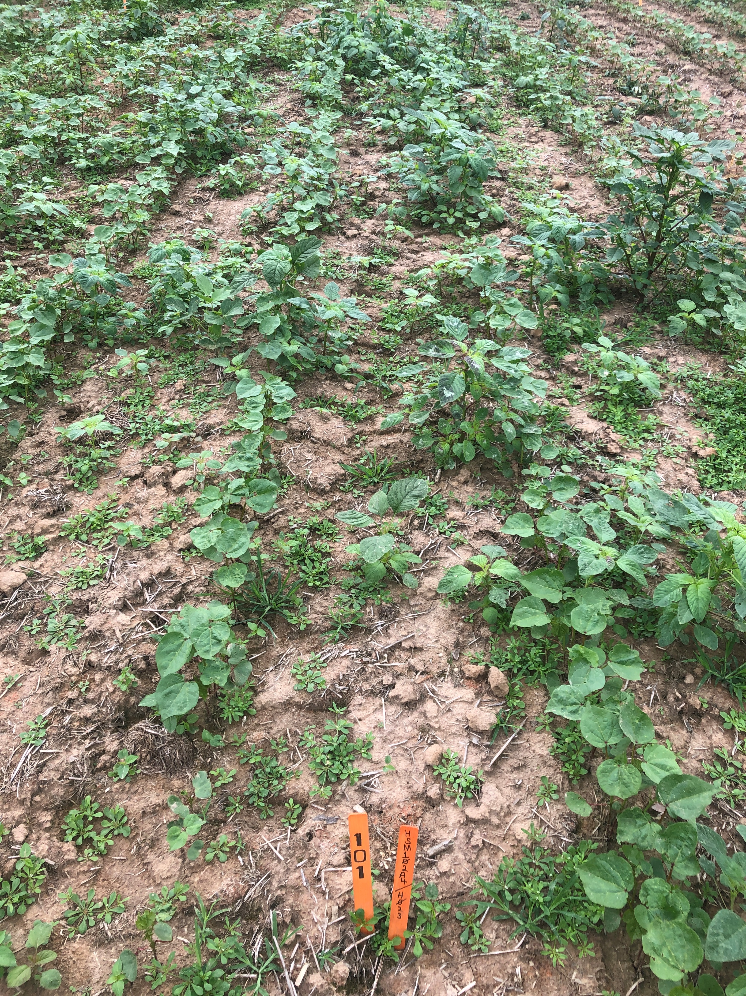
Trt 1: UNTREATED CHECK – 7 DAA

Slide 27
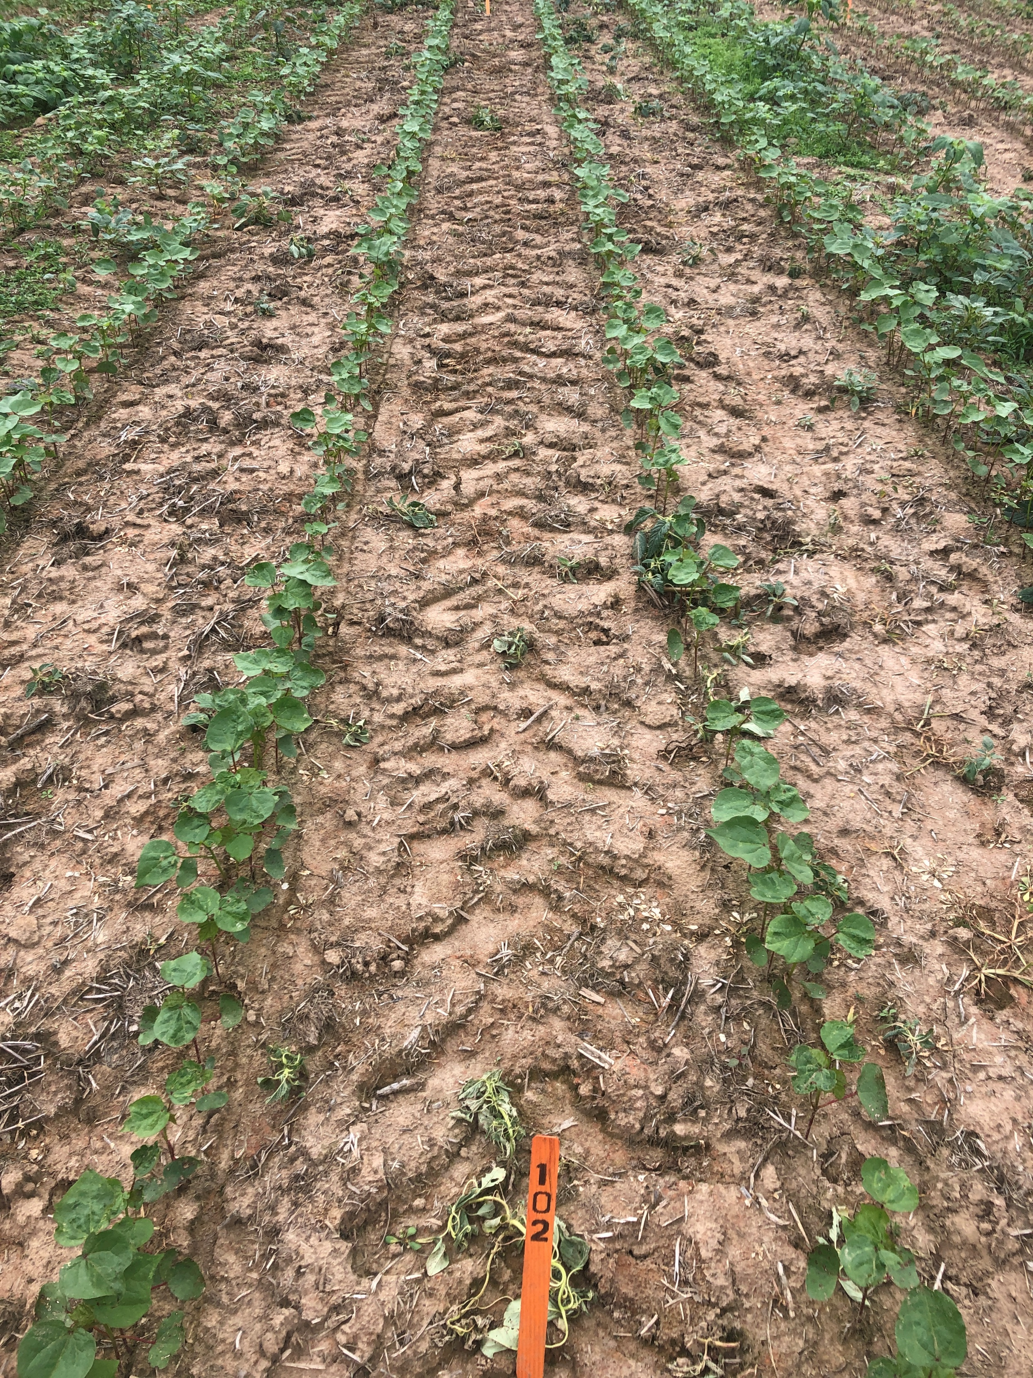
Trt 2: CLASS ACT RIDION 1 % v/v + ENLIST ONE 3.8 SL 1060 g ae/ha + ROUNDUP POWERMAX 4.5 SL 1130 g ae/ha – 7 DAA

Slide 28
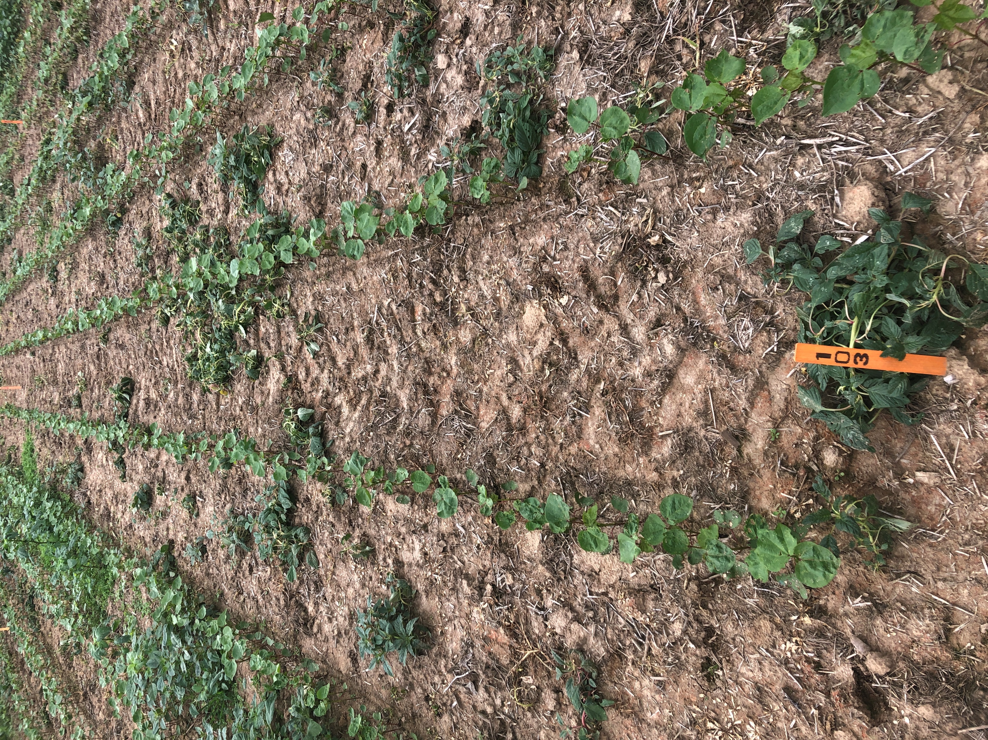
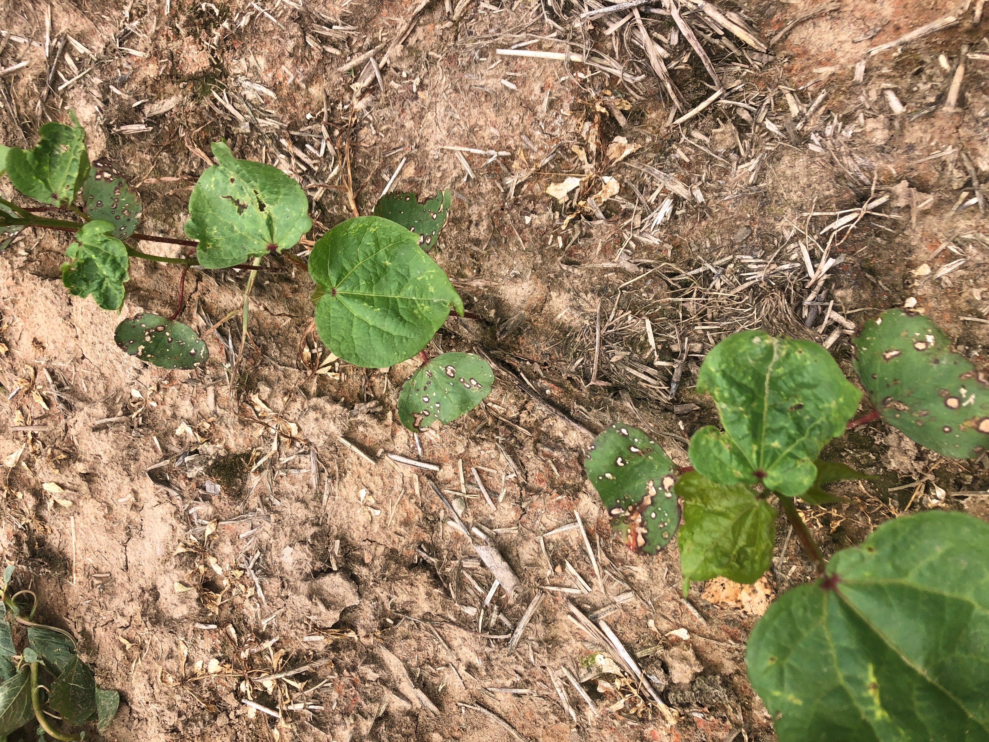
Trt 3: CLASS ACT RIDION 1 % v/v + DUAL MAGNUM 1420 g a/ha + ENLIST ONE 3.8 SL 1060 g ae/ha + ROUNDUP POWERMAX 4.5 SL 1130 g ae/ha – 7 DAA

Slide 29
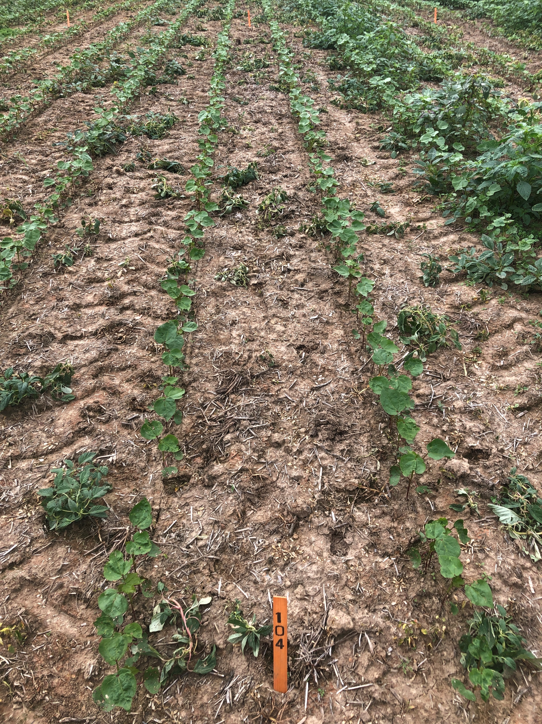
Trt 4: CLASS ACT RIDION 1 % v/v + SEQUENCE 5.25 EW 2570 g ae/ha + ENLIST ONE 3.8 SL 1060 g ae/ha – 7 DAA

Slide 30
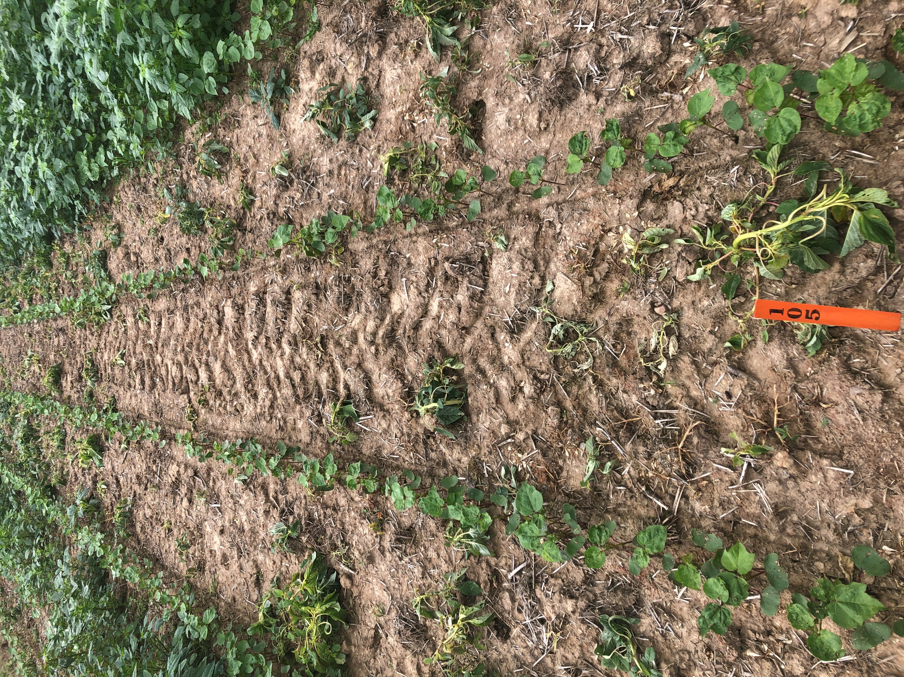
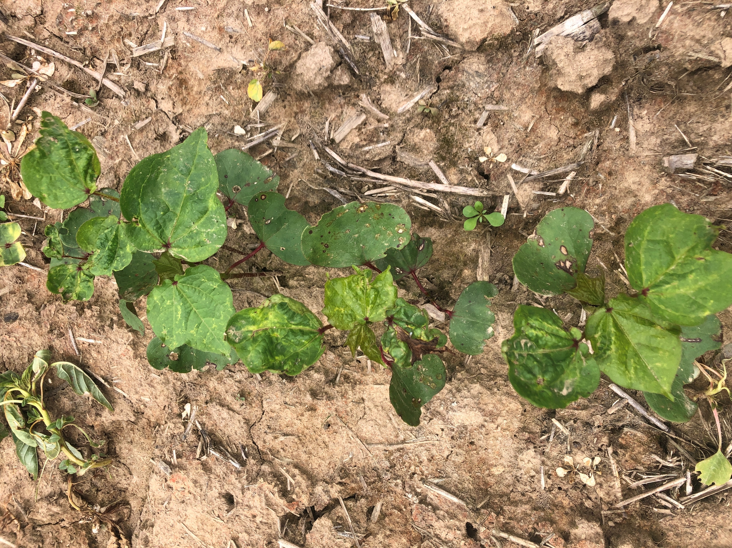
Trt 5: CLASS ACT RIDION 1 % v/v + ENVOKE 75 WG 7.88 g a/ha + ENLIST ONE 3.8 SL 1060 g ae/ha + ROUNDUP POWERMAX 4.5 SL 1130 g ae/ha – 7 DAA

Slide 31
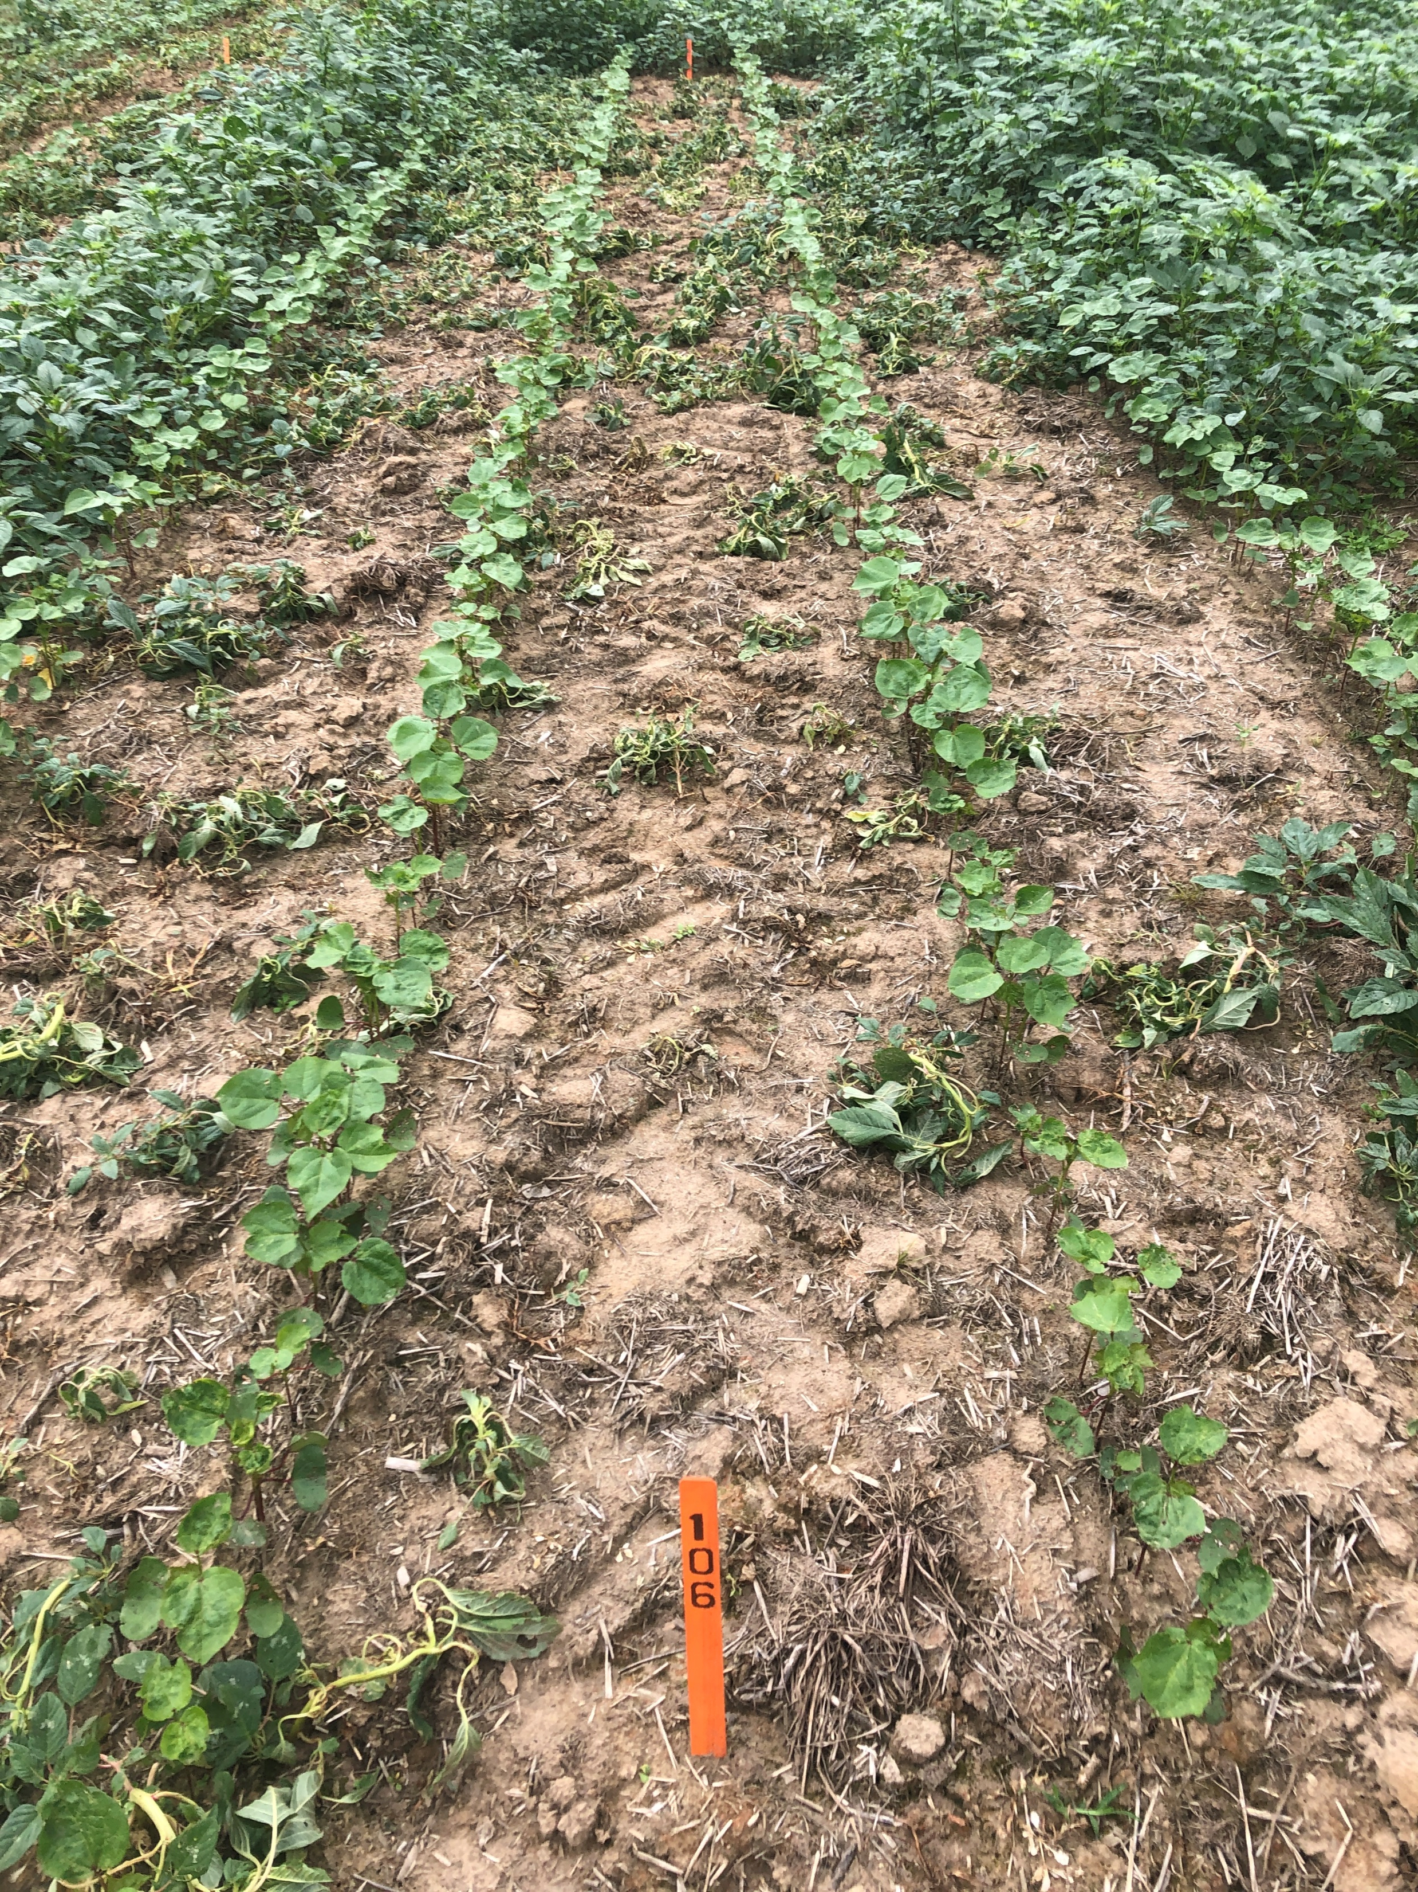
Trt 6: CLASS ACT RIDION 1 % v/v + ENLIST DUO 2210 g ae/ha – 7 DAA

Slide 32
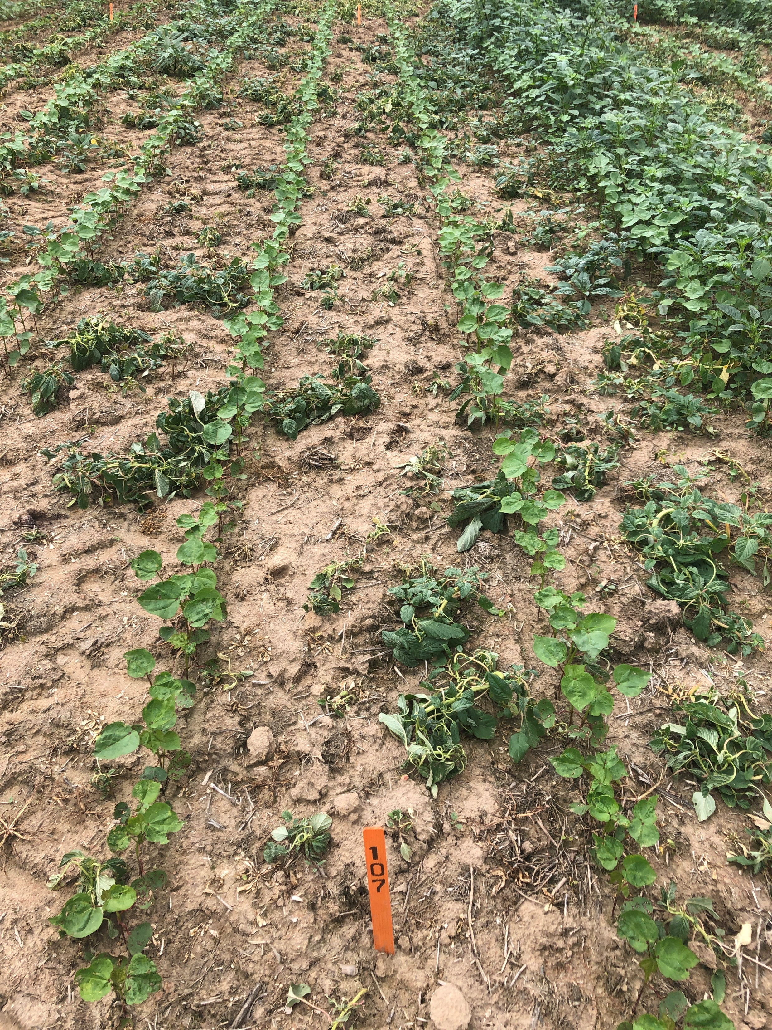
Trt 7: CLASS ACT RIDION 1 % v/v + DUAL MAGNUM 1420 g a/ha + ENLIST DUO 2210 g ae/ha – 7 DAA

Slide 33
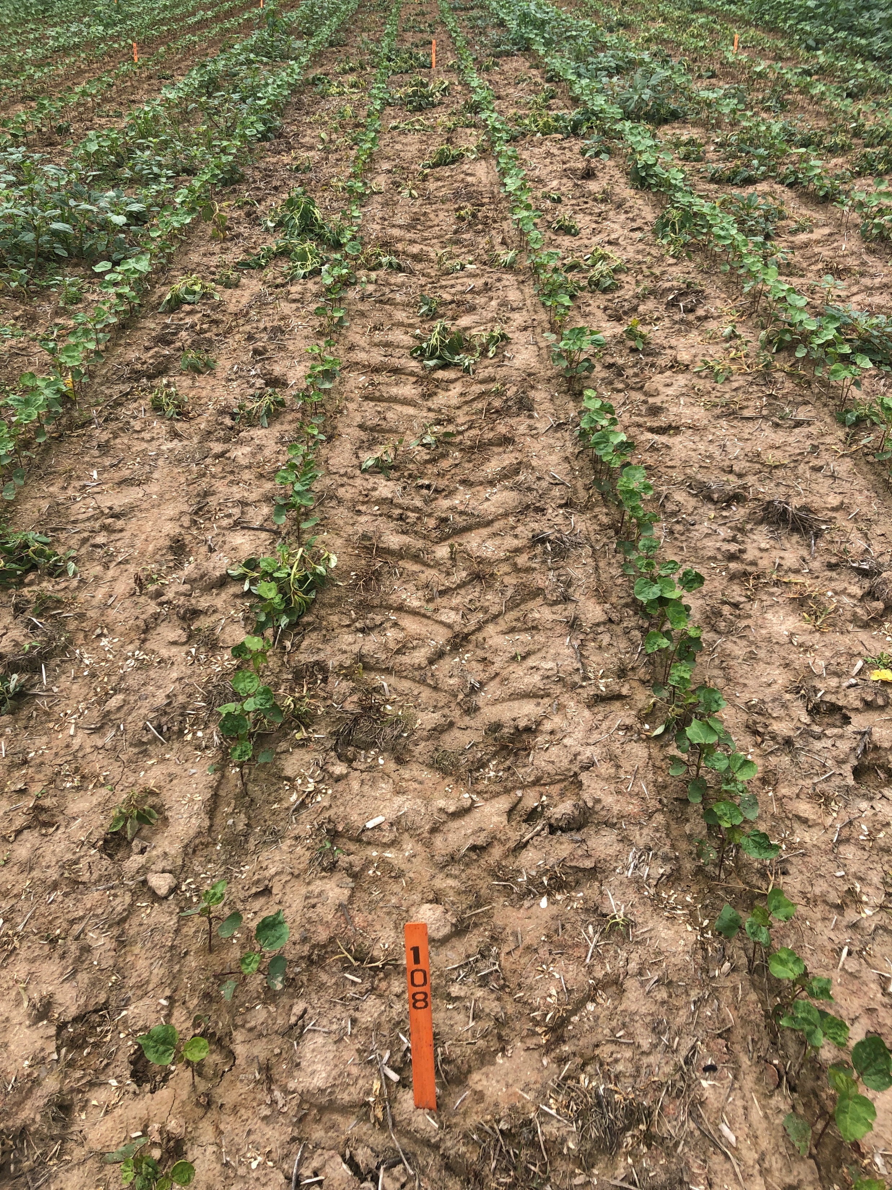
Trt 8: CLASS ACT RIDION 1 % v/v + ENVOKE 75 WG 7.88 g a/ha + ENLIST DUO 2210 g ae/ha – 7 DAA

Slide 34
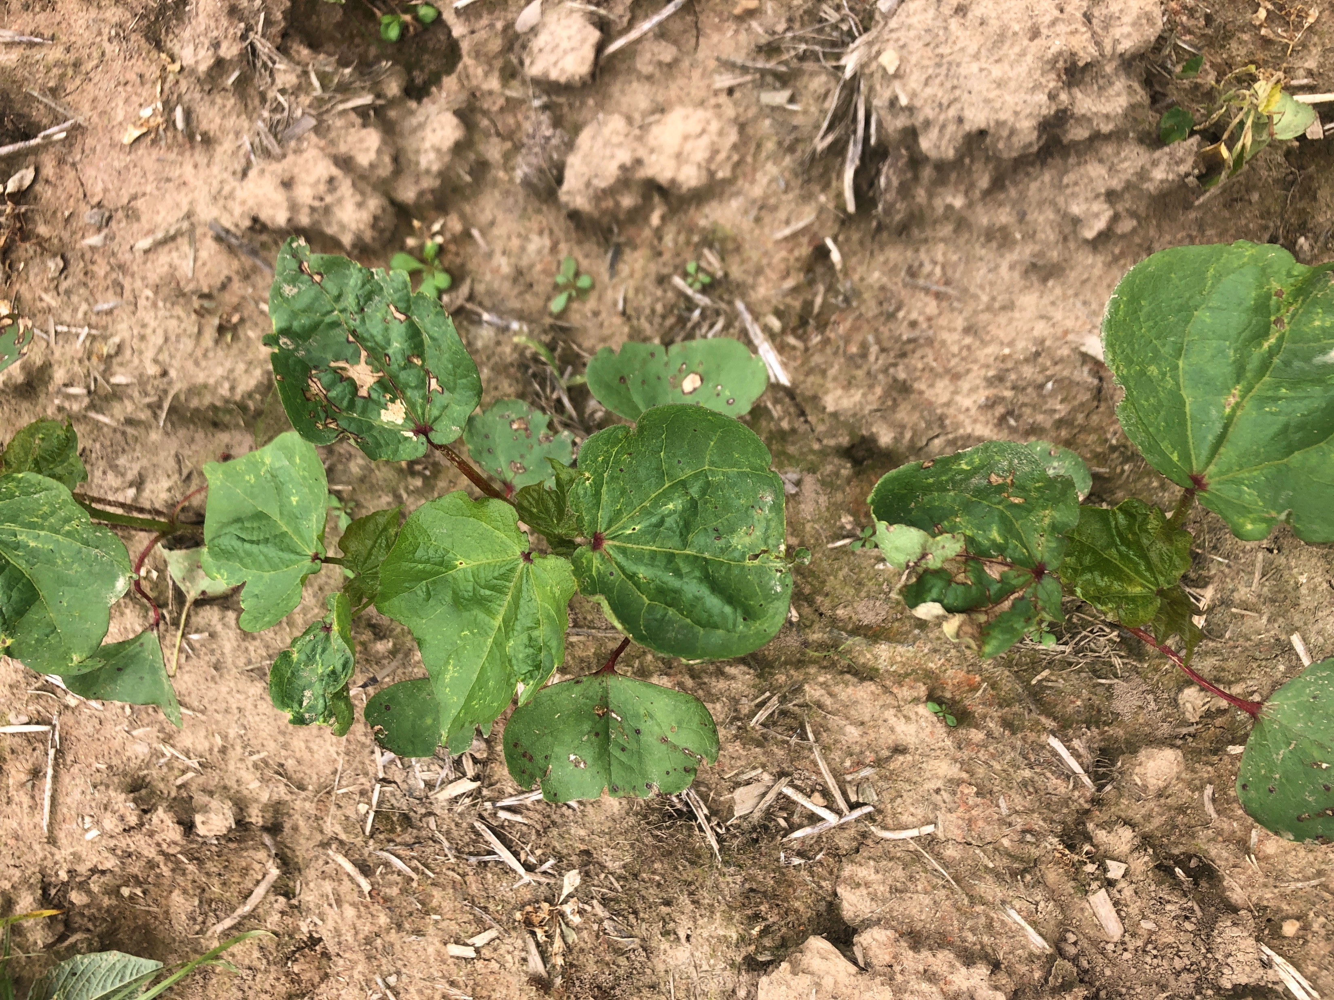
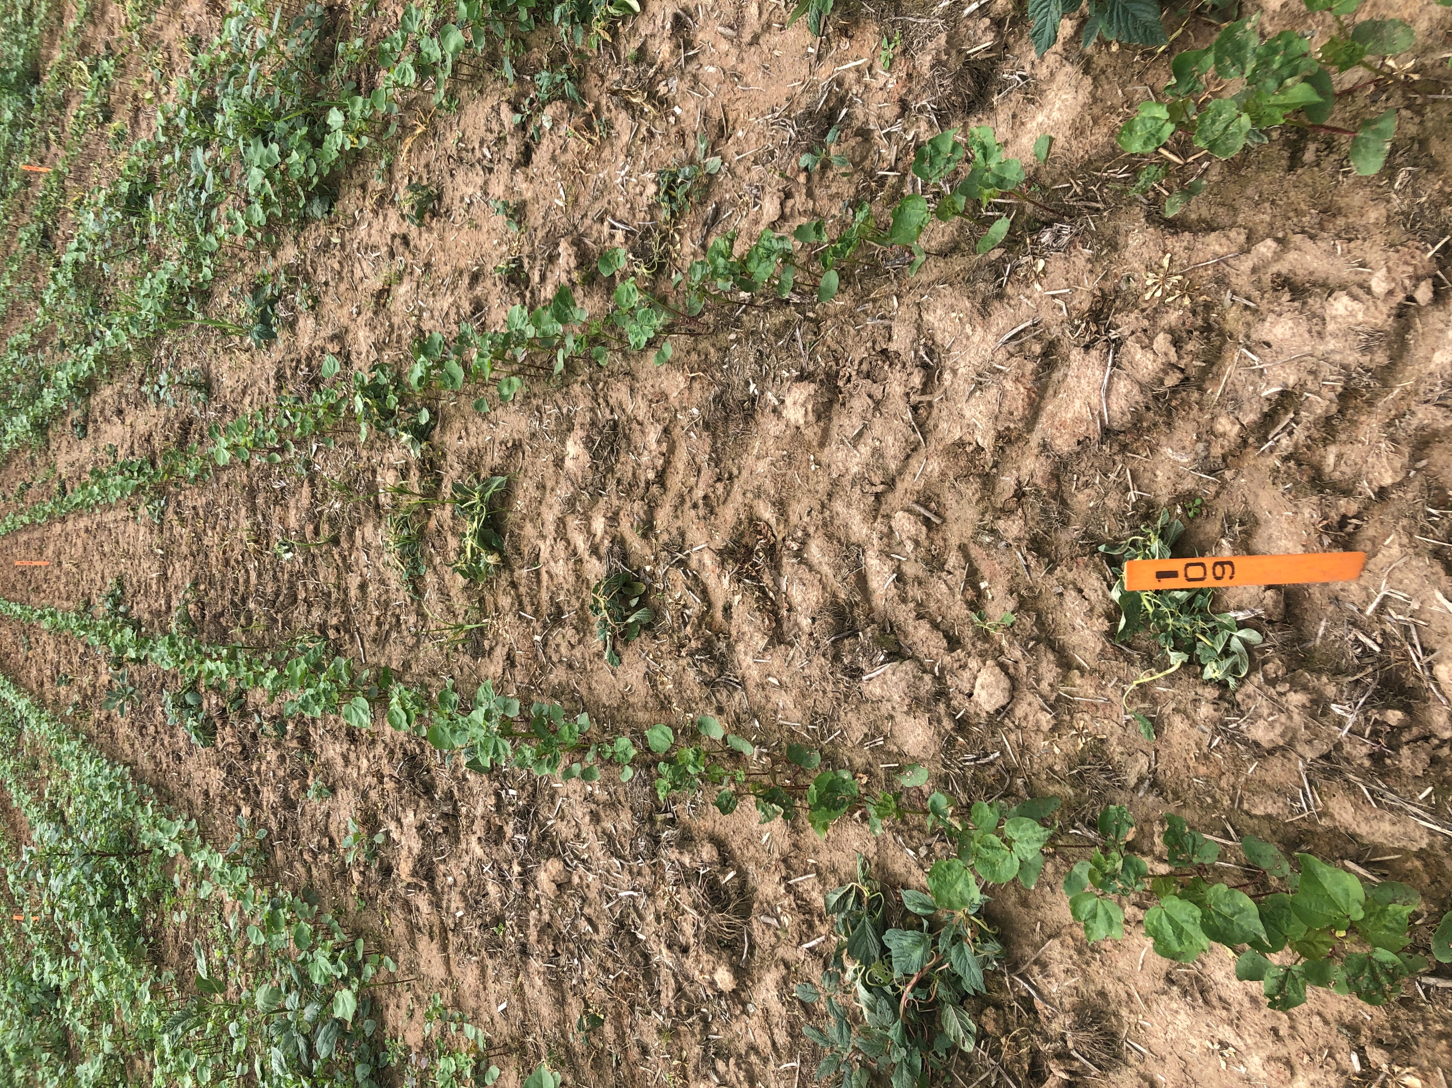
Trt 9: CLASS ACT RIDION 1 % v/v + WARRANT 3 CS 1260 g a/ha + ENLIST ONE 3.8 SL 1060 g ae/ha + ROUNDUP POWERMAX 4.5 SL 1130 g ae/ha – 7 DAA

Slide 35
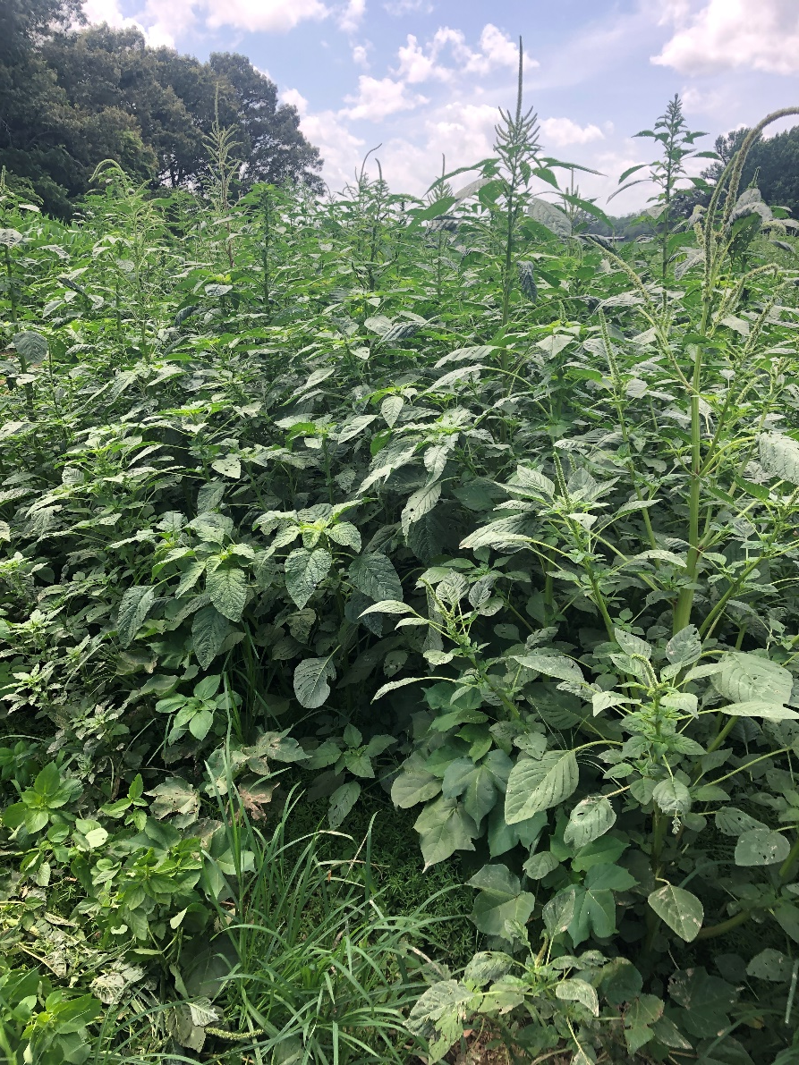
Trt 1: UNTREATED CHECK - TN 28 DAA

Slide 36
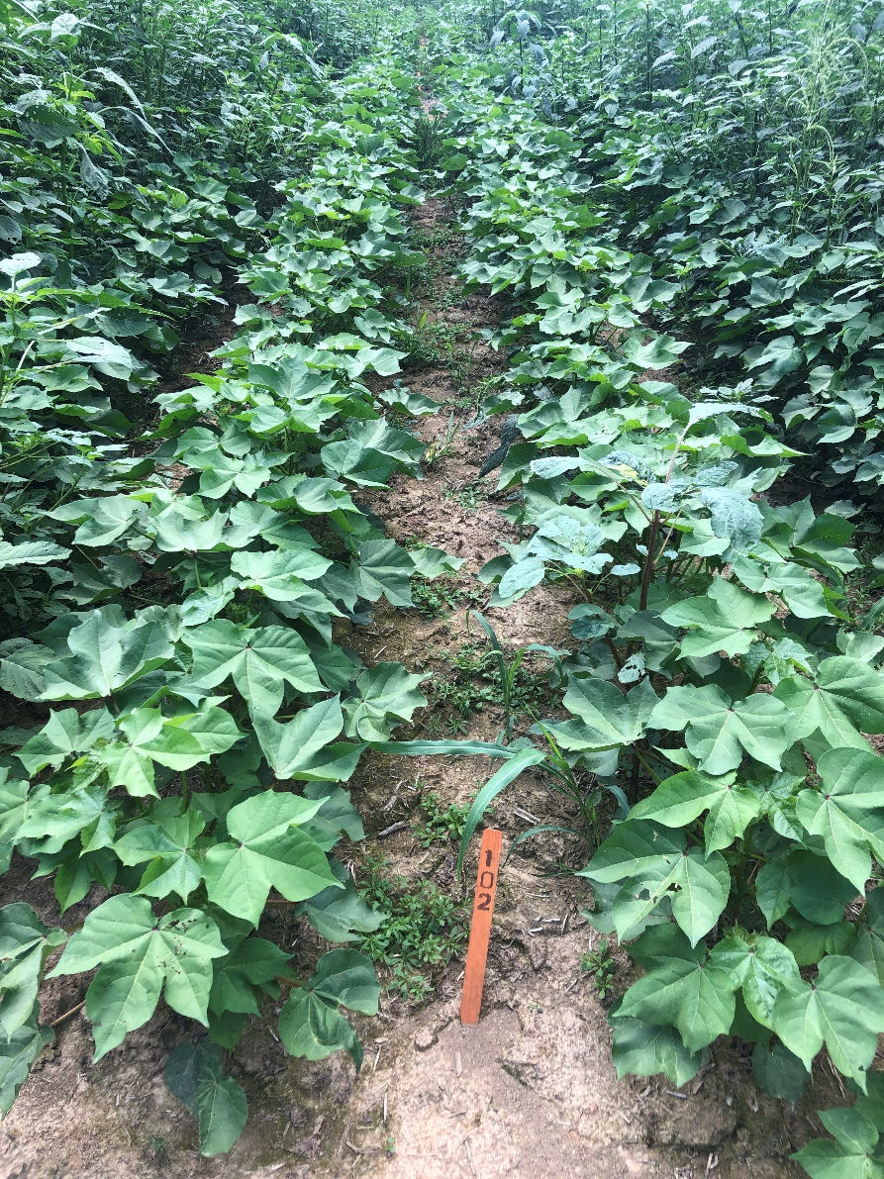
Trt 2: CLASS ACT RIDION 1 % v/v + ENLIST ONE 3.8 SL 1060 g ae/ha + ROUNDUP POWERMAX 4.5 SL 1130 g ae/ha - TN 28 DAA

Slide 37
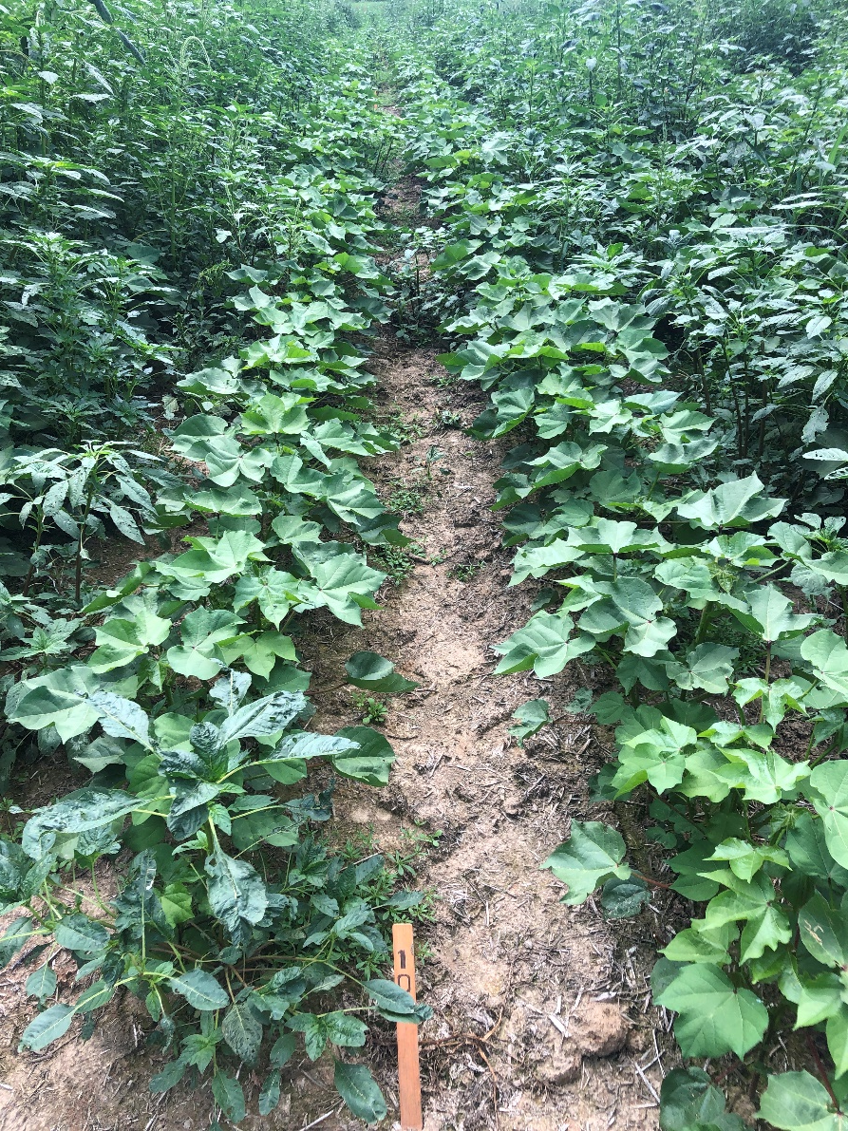
Trt 3: CLASS ACT RIDION 1 % v/v + DUAL MAGNUM 1420 g a/ha + ENLIST ONE 3.8 SL 1060 g ae/ha + ROUNDUP POWERMAX 4.5 SL 1130 g ae/ha - TN 28 DAA

Slide 38
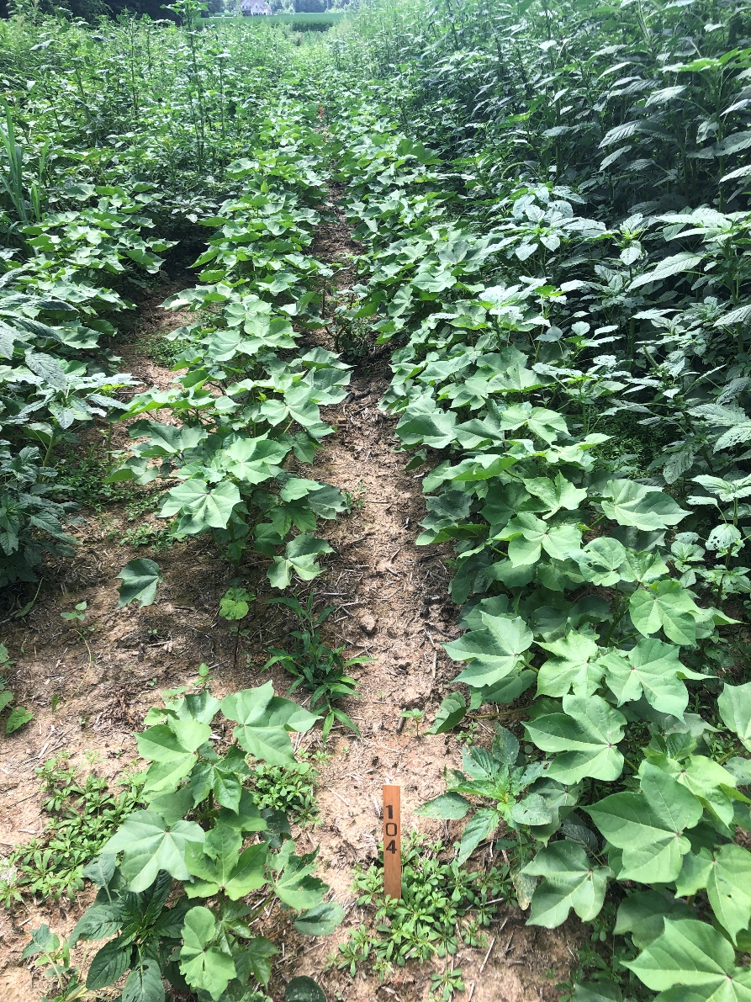
Trt 4: CLASS ACT RIDION 1 % v/v + SEQUENCE 5.25 EW 2570 g ae/ha + ENLIST ONE 3.8 SL 1060 g ae/ha - TN 28 DAA

Slide 39
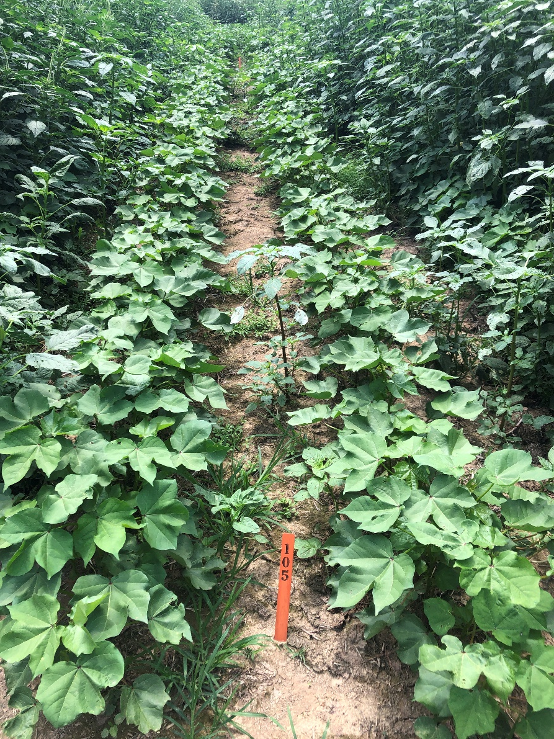
Trt 5: CLASS ACT RIDION 1 % v/v + ENVOKE 75 WG 7.88 g a/ha + ENLIST ONE 3.8 SL 1060 g ae/ha + ROUNDUP POWERMAX 4.5 SL 1130 g ae/ha - TN 28 DAA

Slide 40
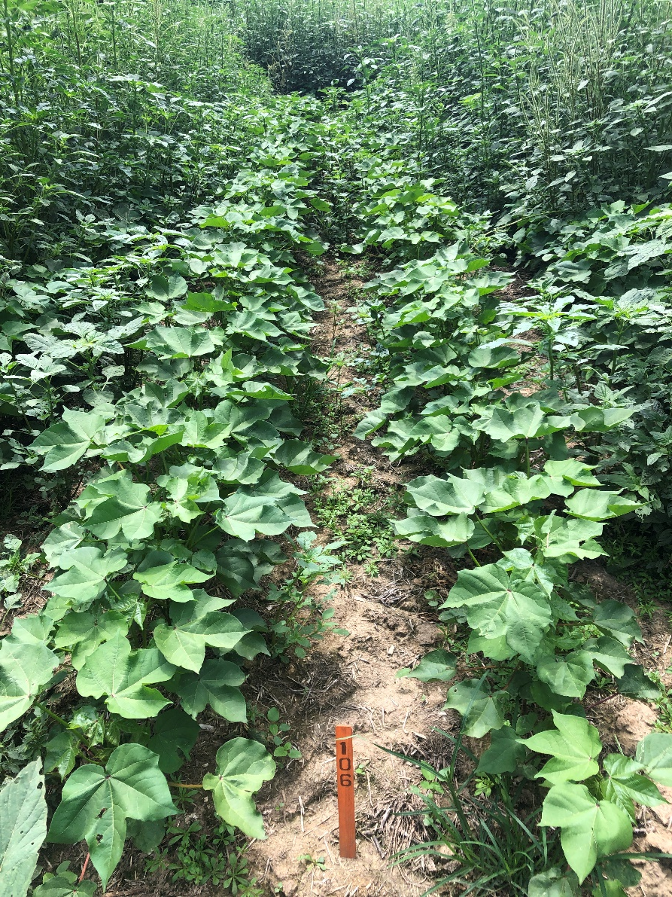
Trt 6: CLASS ACT RIDION 1 % v/v + ENLIST DUO 2210 g ae/ha - TN 28 DAA

Slide 41
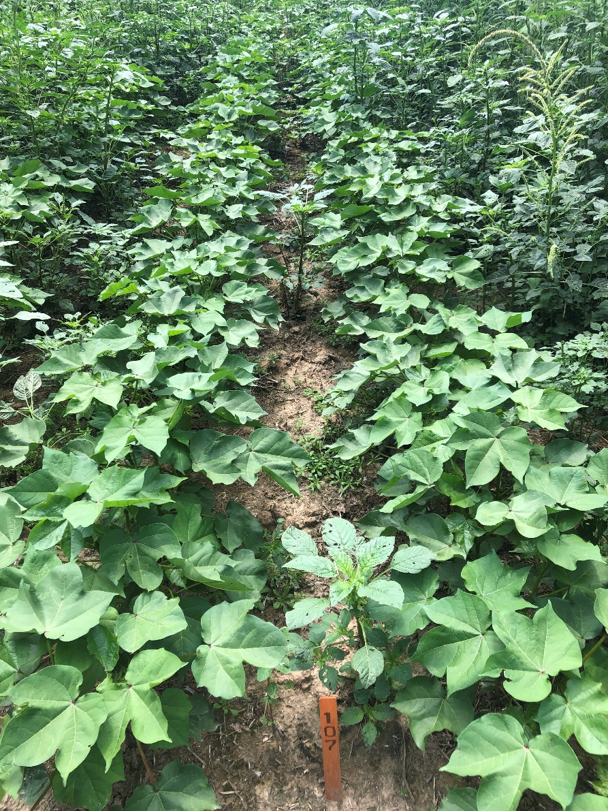
Trt 7: CLASS ACT RIDION 1 % v/v + DUAL MAGNUM 1420 g a/ha + ENLIST DUO 2210 g ae/ha - TN 28 DAA

Slide 42
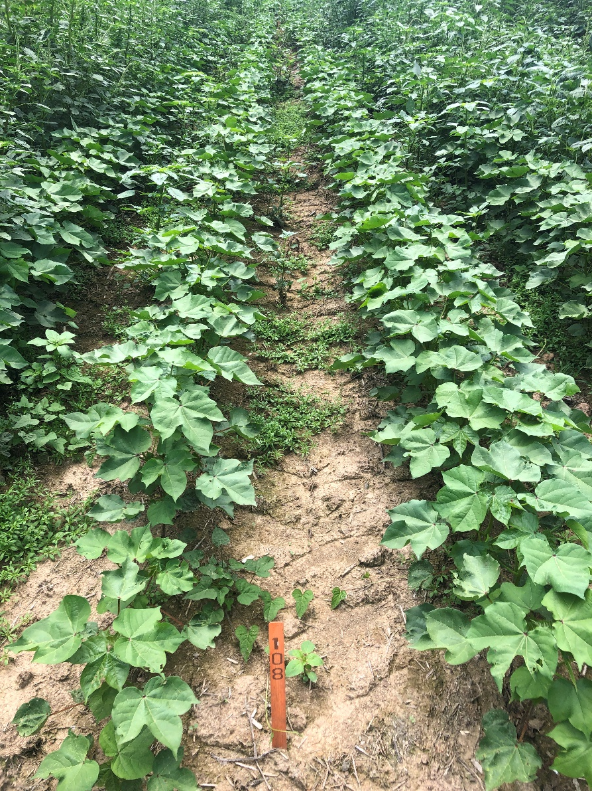
Trt 8: CLASS ACT RIDION 1 % v/v + ENVOKE 75 WG 7.88 g a/ha + ENLIST DUO 2210 g ae/ha - TN 28 DAA

Slide 43
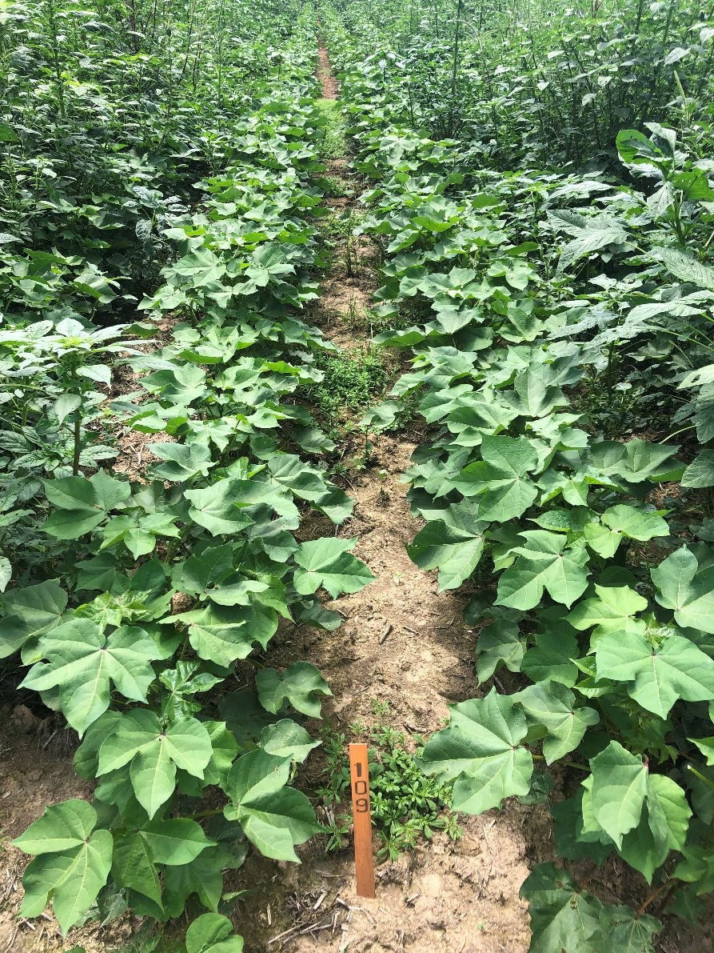
Trt 9: CLASS ACT RIDION 1 % v/v + WARRANT 3 CS 1260 g a/ha + ENLIST ONE 3.8 SL 1060 g ae/ha + ROUNDUP POWERMAX 4.5 SL 1130 g ae/ha - TN 28 DAA

